Slide 1
Data Structures

Slide 2
Introduction
Data Structures: Ways to store and organize data.
For different type of data we use different data structures. The choice of data structures may depend on the following factors:
What needs to be stored?
Cost of Operations
Memory Usage
Ease of Implementation(may not be a Primary Factor)
What would be the best Data Structure to Organize Hierarchical data? For example organizational hierarchy of some company?

Slide 3
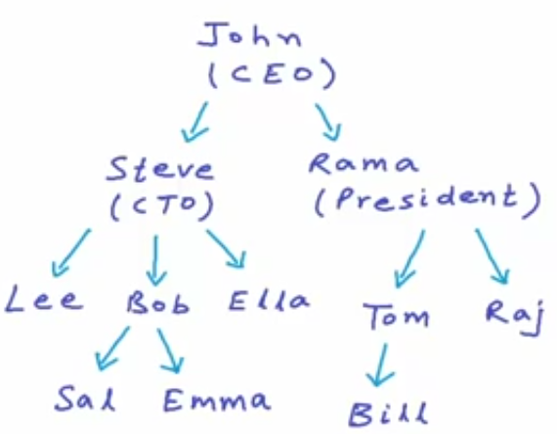

Trees
Tree is a non-linear data structure.
Each node may contain some data and link to other nodes.

Slide 4
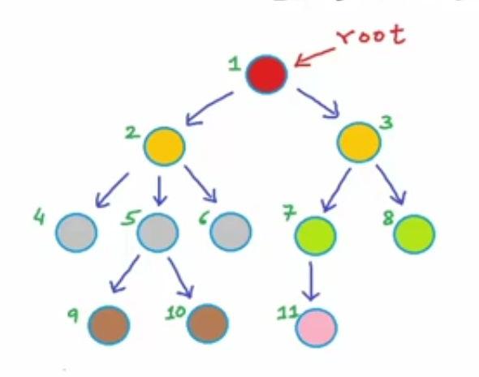
Some Terminologies:
Root
Children
Parent
Sibling
Leaf
Ancestor

Slide 5
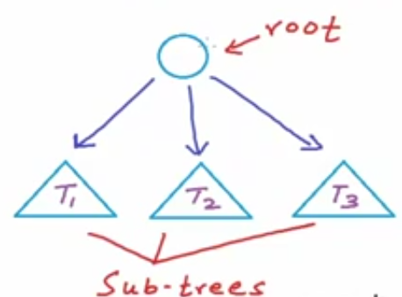
Tree is a Recursive Data Structure

Slide 6
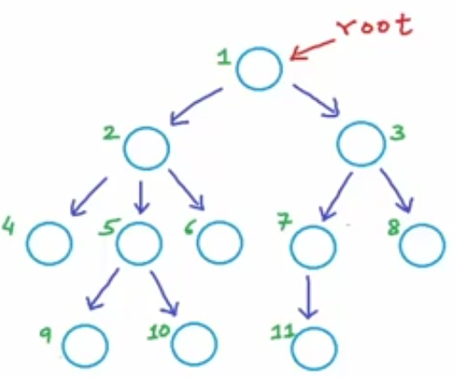
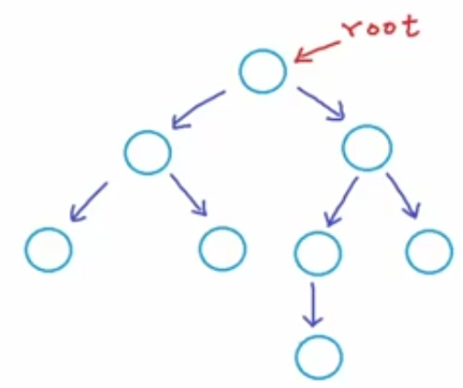
Binary Tree
A tree in which each node can have at max 2 children.

Slide 7
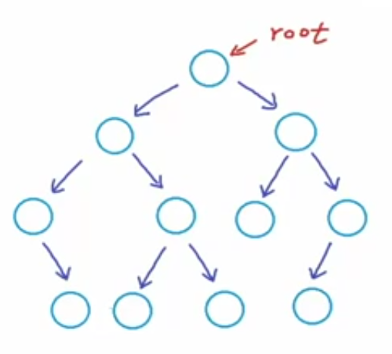
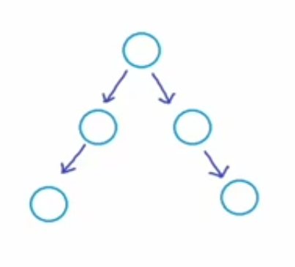
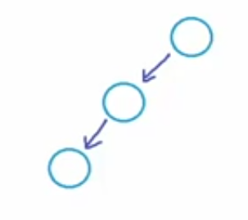
Which of these are Binary Trees?

Slide 8
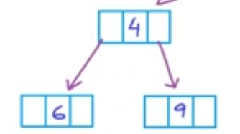
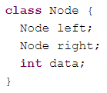
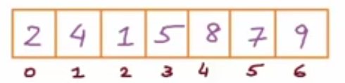
Implementation
We can implement Binary Trees using:
Dynamically created nodes
b) Arrays
For node at index i:
Left-child-index: 2i+1
Right-child-index: 2i+2
Parent = (Child – 1)/2

Slide 9
Implementation
For node at index i:
Left-child-index: 2i+1
Right-child-index: 2i+2
Index | Left Child Index | Right Child Index
0 | 1 | 2
1 | 3 | 4
2 | 5 | 6
i | 2*i + 1 | 2i+2

Slide 10
Implementation
Index | Left Child Index | Right Child Index
0 | 1 | 2
1 | 3 | 4
2 | 5 | 6
i | 2*i + 1 | 2i+2

Slide 11
Implementation
Child | Eq1 | Eq2 | Real Parent
0 | -1 | -1 | No Parent
1 | 0 | -1 | 0
2 | 0 | 0 | 0
3 | 1 | 0 | 1
4 | 1 | 1 | 1
5 | 2 | 1 | 2
6 | 2 | 2 | 2
Clearly Equation 1 can be used to find parent.
Hence, Parent = (Child – 1)/2

Slide 12
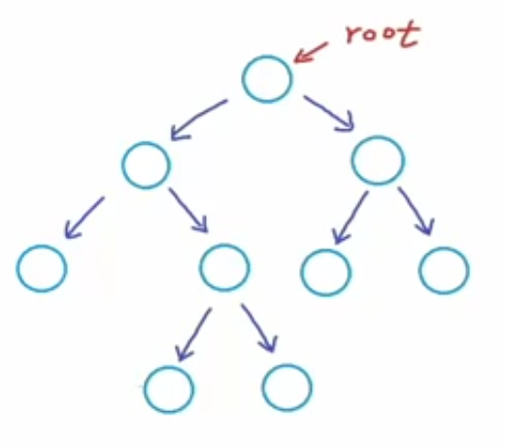
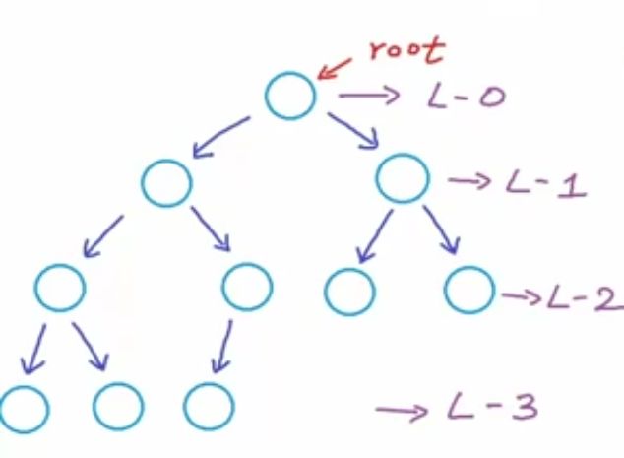
Types of Binary trees
Proper Binary Tree: Each node can have either 2 or no children.
Complete Binary Tree: All levels, possibly except the last are completely filled and all nodes are as left as possible.
Observation: There will be no gaps in the array implementation of a complete Binary Tree.

Slide 13
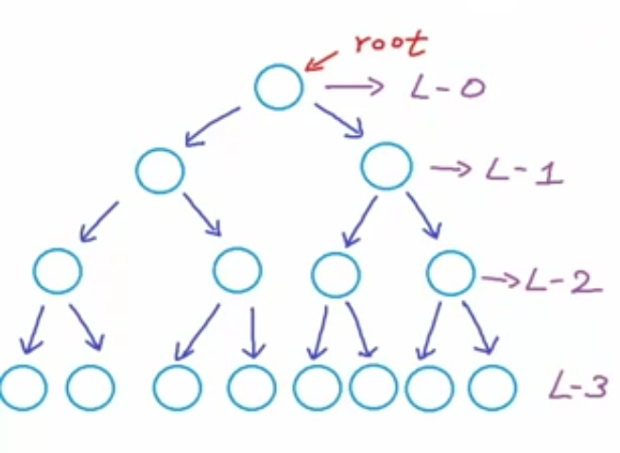
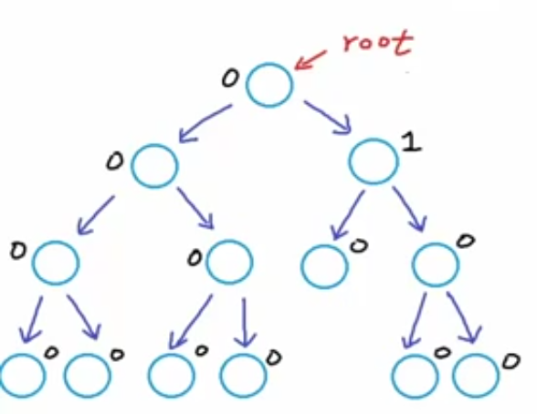
Types of Binary trees
Perfect Binary Tree: If all the levels are completely filled.
Balanced Binary Tree: Difference between the height of left and right subtree for every node is not more than k (mostly k=1).

Slide 14
Types of Binary trees
Balanced Binary Tree: Difference between the height of left and right subtree for every node is not more than k (mostly k=1).

Slide 15
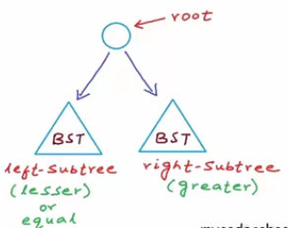
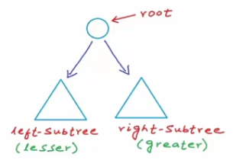
Binary Search Tree
A binary tree in which for each node, value of all the nodes in left subtree is lesser(or equal) and value of all the nodes in right subtree Is greater than the value of that node

Slide 16
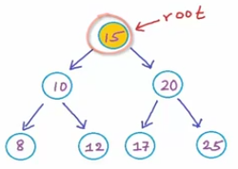
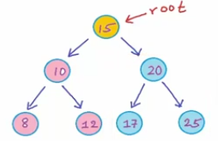
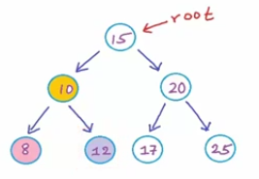
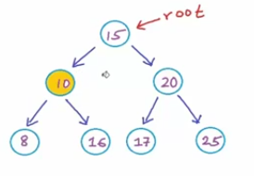
Which of these are BST’s?
1.
2.
No, Not a BST

Slide 17
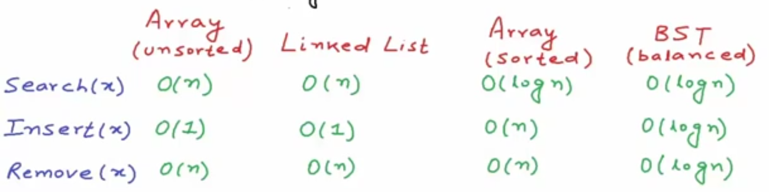
Comparison
What operations do we require for a modifiable collection:
Search(x)
Insert(x)
Remove(x)
What Data Structure can we use?

Slide 18
Creating a Binary Tree

Slide 19
Find the sum of all nodes in a Binary Tree

Slide 20
Dry Run - Sum of all nodes in a Binary Tree

Slide 21
Find the number of nodes in a Binary Tree

Slide 22
Find the number of leaf nodes in a Binary Tree

Slide 23
H.W. -> Find height of a Binary Tree

Slide 24
What’s next?
Traversals BFS
DFS – Preorder (VLR), Inorder(LVR), Postorder(LRV)
Insertion
Deletion

Slide 25
THANK YOU

